Slide 1


Best Practices to Preserve Affordable Housing
Rita Parise
Housing Administrator
Columbus, Ohio

Slide 2


Columbus, Ohio
Population 913,129, metro area 1,687,000
14th largest city in the country
Significant population growth – Columbus’s growth accounts for more than all the population growth in Ohio
Up and coming:
  Intel is building a $20 million manufacturing operation in New Albany – 7,000 construction jobs, 3,000 permanent jobs
  Honda is building a $3.5 billion battery plant with LG in Fayette County

Slide 3
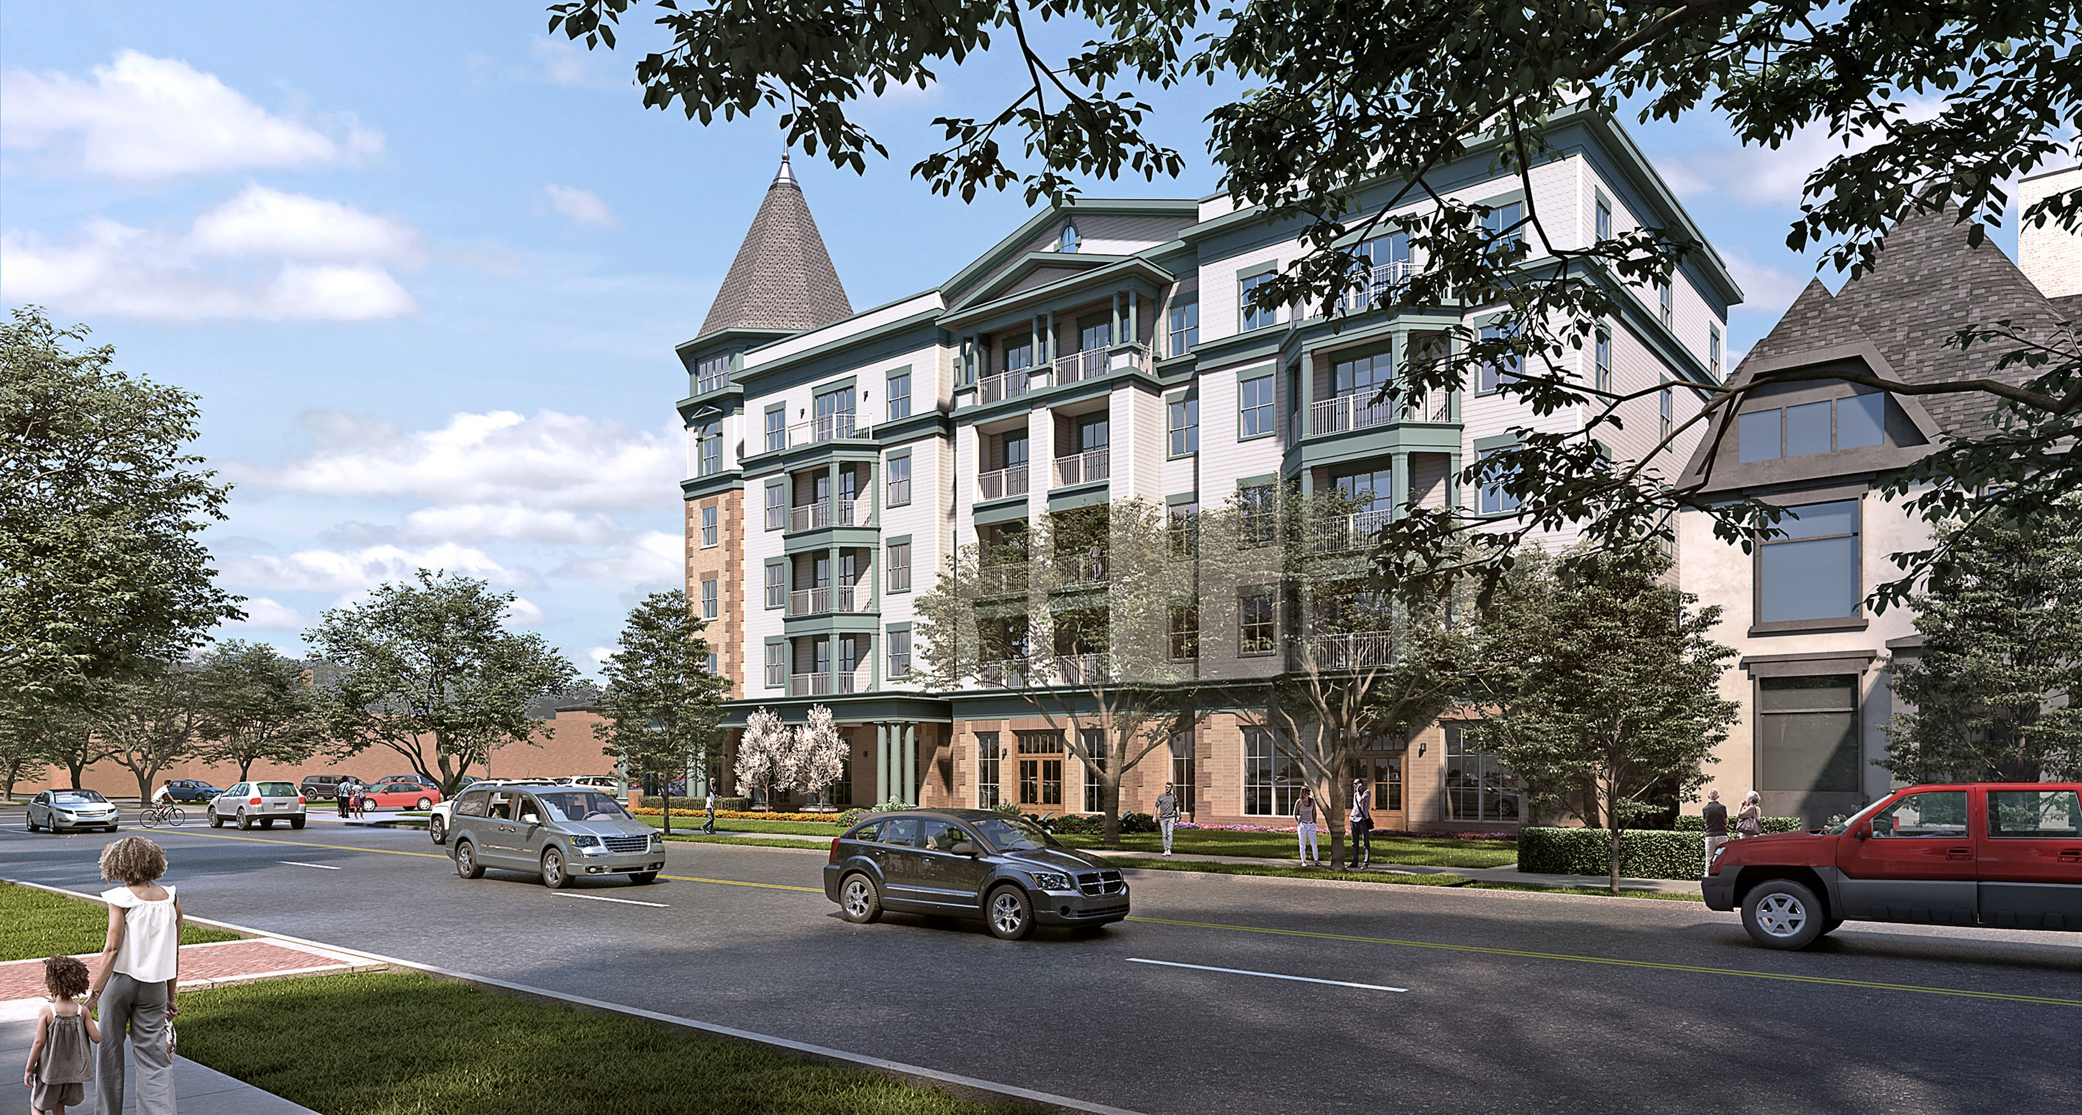
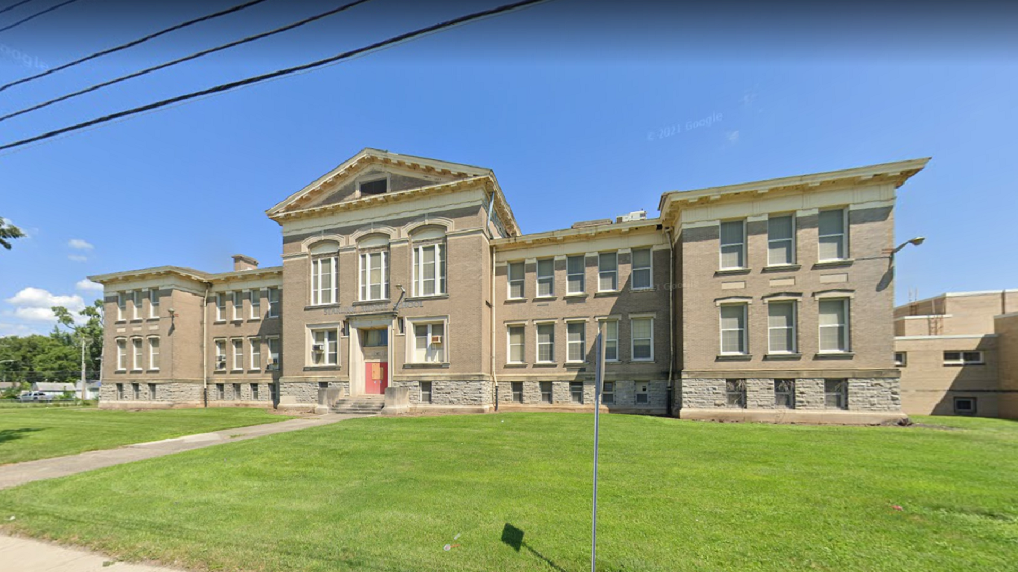
Columbus Housing Market
More housing units at all price points and tenures needed
Sellers market for single family homes
Rents are increasing faster than the rate of inflation
  Apartment communities cannot staff management and maintenance positions
  Households that are employed find themselves homeless because rent is too high
Current zoning code requires almost every development to need zoning variances – proposal in process to revamp the code which will allow for more by right development at higher density.

Slide 4
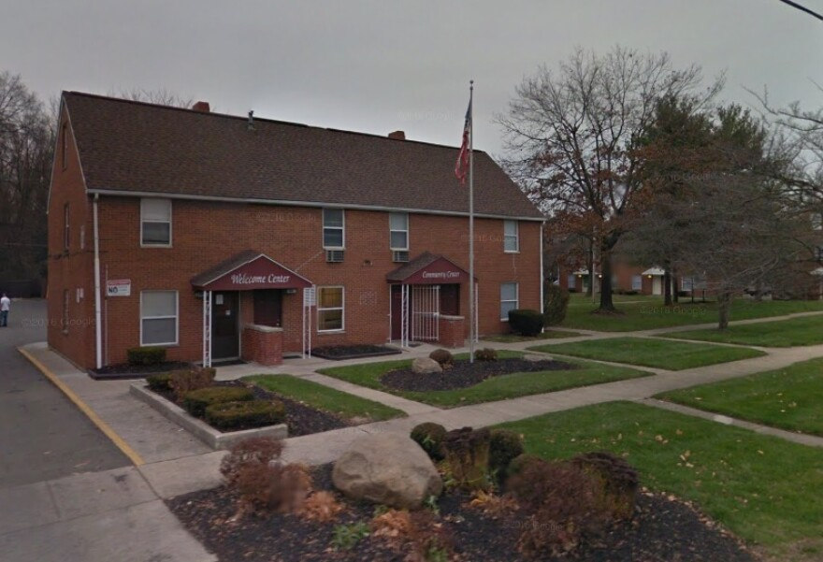
Nelson Park Apartments
177 unit project based Section 8 property
Originally constructed in 1958, rehabbed in 1980
In a two year period - 2016-2018- five murders occurred on site along with multiple incidents of violent crime.
The high number of violent crimes as well as concerns around physical conditions caught the attention of Columbus City Attorney Zach Klein and the Property Action Team

Slide 5
City Attorney Property Action Team
Can file court case to have a property declared a public nuisance
If the nuisance isn’t abated, the property can go into receivership
A receiver will address physical issues of the property and position it for sale
Currently , two properties have been placed into receivership
Property Action Team Approach – regular meetings on site
  Crime – Police and Fire
  Physical Conditions – Code Enforcement, Refuse
  Community Engagement – One attorney in the office has specialized in finding organizations to assist residents with needs; Each Columbus neighborhood has a Neighborhood Liaison and they work to identify resources for the community
  City Housing Staff – reach out to HUD and OHFA, for those who want to rehabilitate, work with them on a plan
  Engage HUD and OHFA when needed – important to have HUD at the table – do not want to see Section 8 contract abated if at all possible

Slide 6

Nelson Park Apartment Response
Agreed to a safety assessment by Columbus police: Police made recommendations for improvements to the site – better lighting, special duty police and private security, security cameras that can be accessed by police
Review of site by the Refuse Division: Are there sufficient dumpsters? Is trash pickup schedule appropriately? Can other changes be made to improve appearance?
Pro-active Code Enforcement (PACE) – unit by unit, building by building code enforcement inspections to determine all issues that the property is facing
Desire by ownership to recapitalize and reposition the property

Slide 7
Redevelopment Proposal
Reduce number of buildings from 47 to 41, Reduce number of units from 177 to 137 maintaining more of the 1 bedroom senior units than the larger family units. There are significant vacancies at the present time but all tenants will be given the option of taking a voucher to live elsewhere.
Transfer Section 8 contract to another property (also in Columbus) due to very low rents (an 8(bb) transaction). FYI the original transfer of Section 8 authority occurred to facilitate redevelopment of a large scattered site portfolio in Columbus.
Obtain project based vouchers from Columbus Metropolitan Housing Authority
Construct a new management office and community center

Slide 8
Challenges Along the Way
The age of the existing buildings means that they are historic. Efforts to reconfigure the site were limited because SHPO did not want the new management office and community center to be in the center of the development.
Moving the project based Section 8 assistance means having to pay a HUD soft loan of $3,196,516 – lack of HUD flexibility in these instances is very counter-productive to redevelopment efforts.
HUD approvals for moving the project based Section 8 assistance and approved an FHA 221(d)(3) loan have been very slow. Davis Bacon wage rates will be required.
Rapidly increasing costs continue to create financial gaps for completing the project.

Slide 9
Anticipated Capital Stack
FHA 221(d)(3) loan $13,374,000
Gap financing State of Ohio (HOME ARP) $4,000,000
Gap financing City of Columbus $5,000,000
(HOME, HOME ARP, City Capital Funds)
Affordable Housing Trust CDFI Loan $750,000
Interim Income $241,646
Seller Note $949,480
Deferred Developer Fee $2,212,269
General Partner Capital $3,500,000
4% LIHTC and Historic Credit Equity $21,289,909
Total $51,317,304

Slide 10
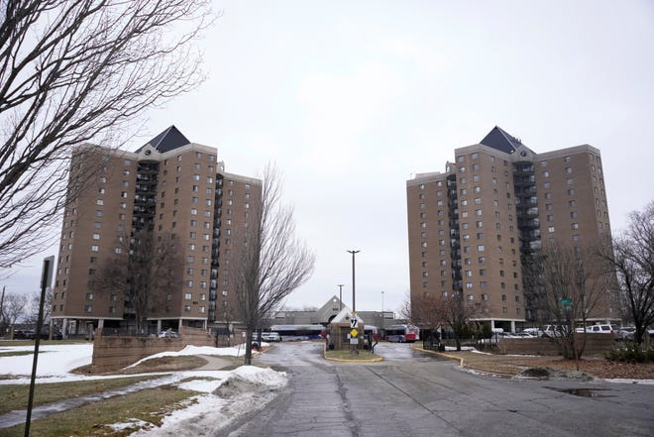
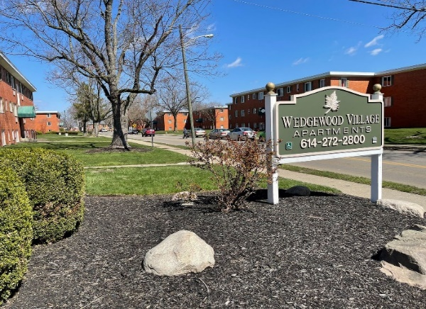
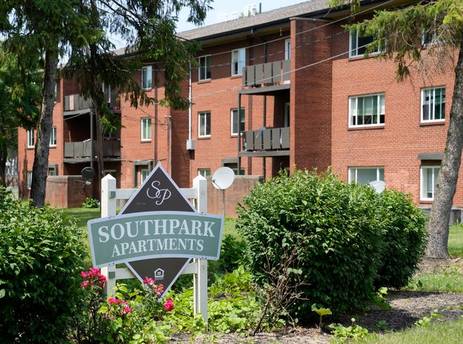
Other Troubled Properties in Columbus
Sawyer Towers – aka Latitude 525 -392 units - vacated Christmas Day 2022 due to multiple water line breaks- in receivership and for sale
Colonial Village – 508 units - November 2023 more than 800 Haitian refugees were found living in vacated apartments without electric and hot water, subsequently all units were vacated by the receiver
Wedgewood Village – highest crime rate in Columbus – 648 units with project based Section 8 – owners have put it up for sale
Southpark Apartments – aka Greenwood Village – 352 units with project based Section 8- recapitalized with LIHTC and private activity bonds in 2018 – high crime, physical conditions – under a consent order with the city

Slide 11
Questions?
Rita R. Parise
Housing Administrator
Housing Division
111 North Front St, Third Floor
Columbus, Ohio
614-645-6115 direct line
rrparise@columbus.gov

